Slide 1
Digital Image Processing in Python
Marcus Gallagher-Jones – marcusgj13@gmail.com
Day1
03/05/2019
https://github.com/marcusgj13/W21.DigitalImageProcessing

Slide 2
Course overview
Day 1
Introduction to core concepts in image processing.
Introduction to Jupyter and quick python Review.
Manipulating matrices with numpy.
Loading and inspecting images with python and matplotlib.
Day 2
Scikit-image for image processing.
Useful algorithms for image processing.
Day 3
Application of concepts learned on Day 1 and 2 to a real dataset.

Slide 3
What are the goals of this course?
This course should give you basic knowledge of the steps in image processing for your own studies.
You should hopefully leave with some tools for exploring your own images and the knowledge of where to find other things you may need.
This course will not touch on more advanced topics like advanced neural networks and machine learning.
Image processing is about extracting the relevant data from your measurements, but not about analyzing them.

Slide 4

What is an Image?
Reality is a continuous function - f(x,y).
Most acquisition systems are made up of pixels. Computers store information as bits.
When we measure something therefore it is necessary to discretize as our sampling is limited.

Slide 5
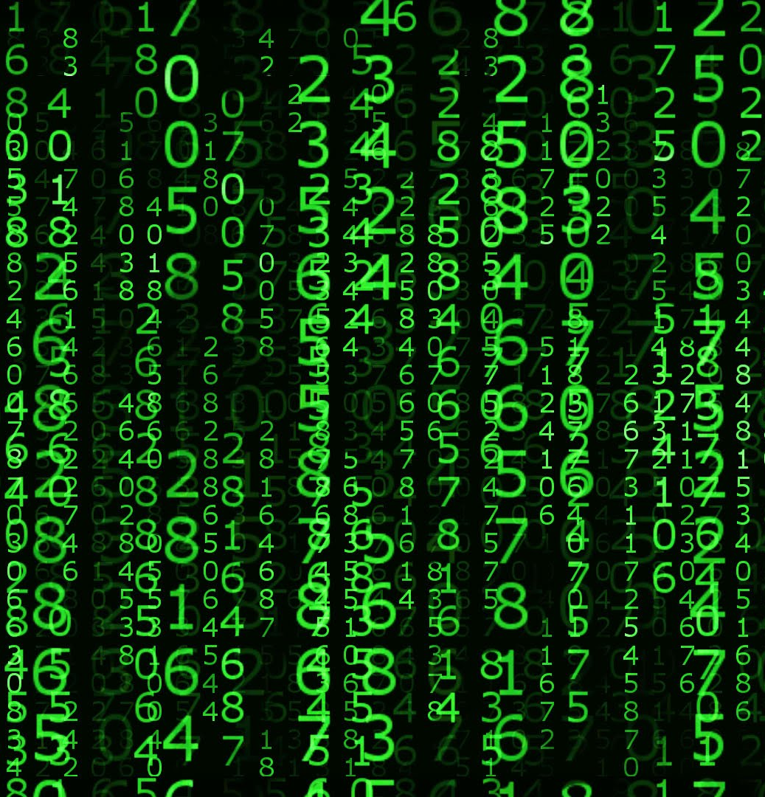
What is an Image?
An image on a computer is a 2D matrix that contains a series of locations and values.
The values contain information about a property we would like to measure.
We can perform mathematical and computational operations to manipulate and extract the most relevant information (Image analysis).

Slide 6
Why do we need image processing?
All imaging systems are imperfect.
The values contain information about a property we would like to measure.
We can perform mathematical and computational operations to manipulate and extract the most relevant information (Image analysis).

Slide 7
Some definitions
Image processing – Manipulation of a digital image. Image in > Image out.
Image Analysis – Extraction of useful information from an image. Image in > Data out
Matrix – An n-dimensional array of values.
Pixel – Intersection of columns (m) and rows (n) that typically contains intensity information or values.
Row/Column-major order – The order in which from n-dimensional array is read in by a computer (python is row-major).
Bit depth – The amount of information an image can store.

Slide 8
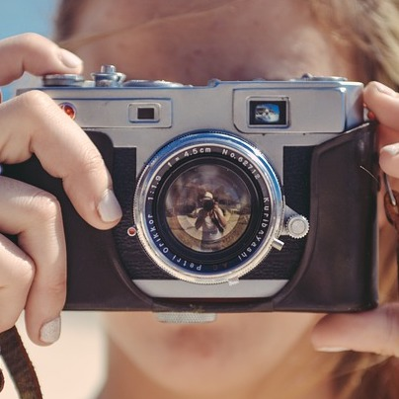
What might an image processing pipeline look like?
Image acquisition

Slide 9
What might an image processing pipeline look like?
Image acquisition
Image Preprocessing
Aligning
Affine transforms
Denoising
Filtering

Slide 10
What might an image processing pipeline look like?
Image acquisition
Image Preprocessing
Aligning
Affine transforms
Denoising
Filtering
Image Processing
Edge detection
Segmentation
Feature extraction
Clustering

Slide 11
What might an image processing pipeline look like?
Image acquisition
Image Preprocessing
Aligning
Affine transforms
Denoising
Filtering
Image Processing
Edge detection
Segmentation
Feature extraction
Clustering
Image Analysis
Conversion to data
Fitting features
Statistical treatment
Modelling

Slide 12
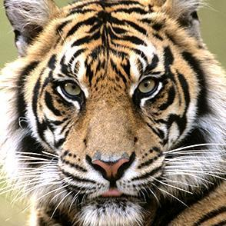
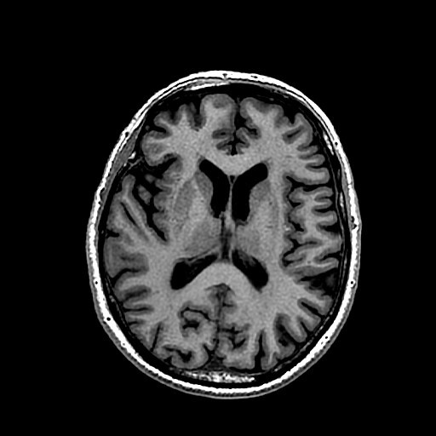
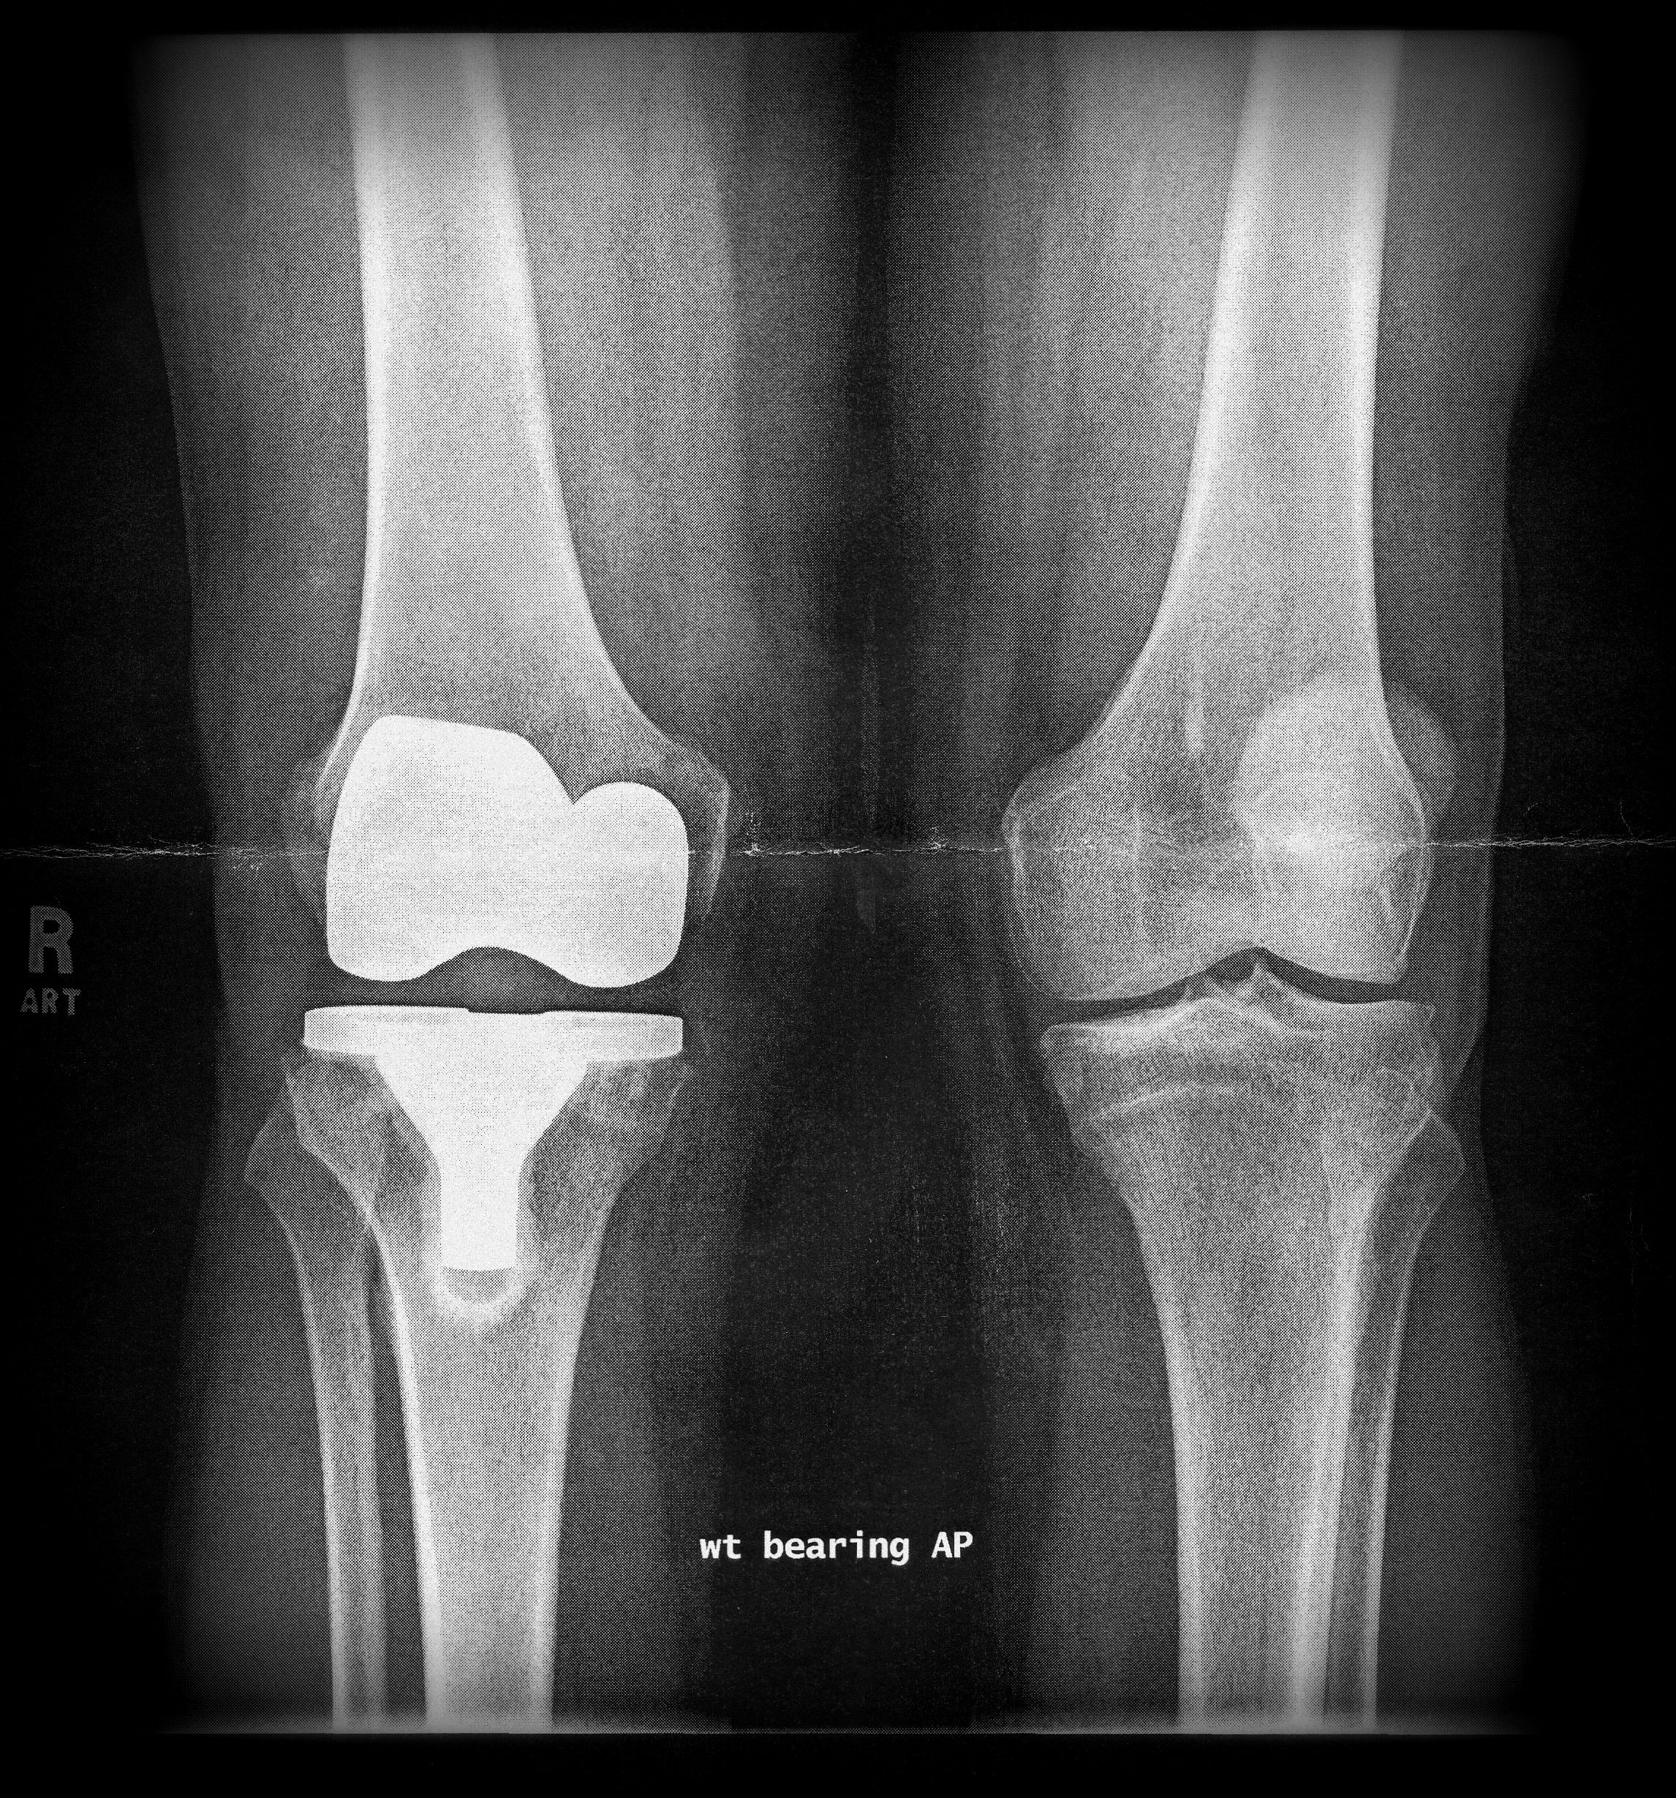
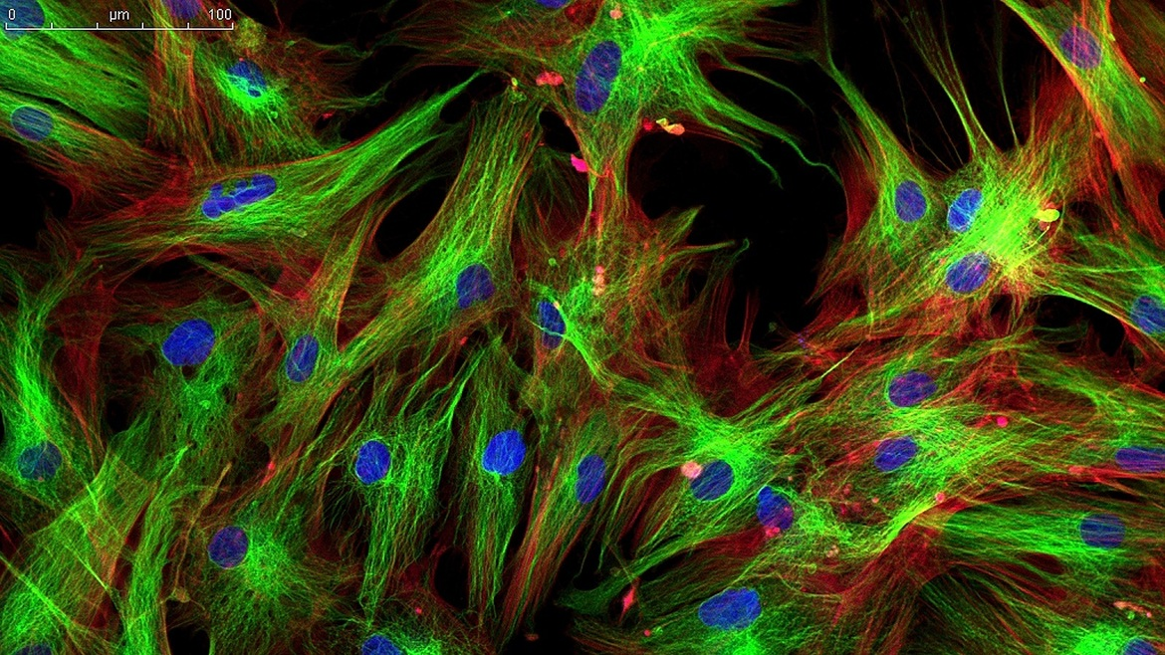
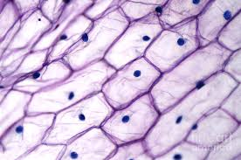
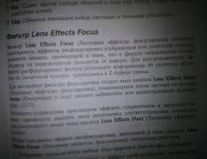
What kinds of images might we look at?

Slide 13
Image formats and compression
It is important to have your data in the right format for the analysis you would like to perform.
Some formats are considered lossy due to some compression when converting and saving in this format.
Others are lossless, and uncompressed. This is more important when you would like to extract quantitative data from your image. They also tend to have larger file sizes.
Many microscope manufacturers have their own proprietary image types and these will require specific tools to extract data from.

Slide 14
Some common data formats
JPG or JPEG – Typically lossy and small bit depth (values range from 0 to 255). Can be grayscale or RGB, most common on standard digital cameras.
PNG – Lossless image format but not high bit depth (0 to 255). Can also contain an alpha (transparency channel). One of the most common image formats.
TIFF or TIF – Most standard format in scientific image. Generally lossless and can have a bit depth up to 16 bit (0 to 65,535) in both grayscale and color. TIFF files can also be image stacks.
CZI (zeiss) and LIF (Leica) – Proprietary image formats that can contain extra information about imaging and microscopy conditions. Require special readers.

Slide 15
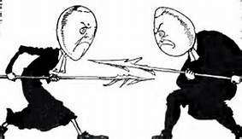
Watch the ends
Endianness refers to the order in which bytes should be read into the computer when reading an image.
When working with a new format it is important to get this right.
Files can be either big-endian or little-endian.

Slide 16
How is image data stored in the computer?
Data type | Range
uint8 | 0 to 255
uint16 | 0 to 65535
uint32 | 0 to 2³² - 1
float | -1 to 1 or 0 to 1
int8 | -128 to 127
int16 | -32768 to 32767
int32 | -2³¹ to 2³¹ - 1

Slide 17




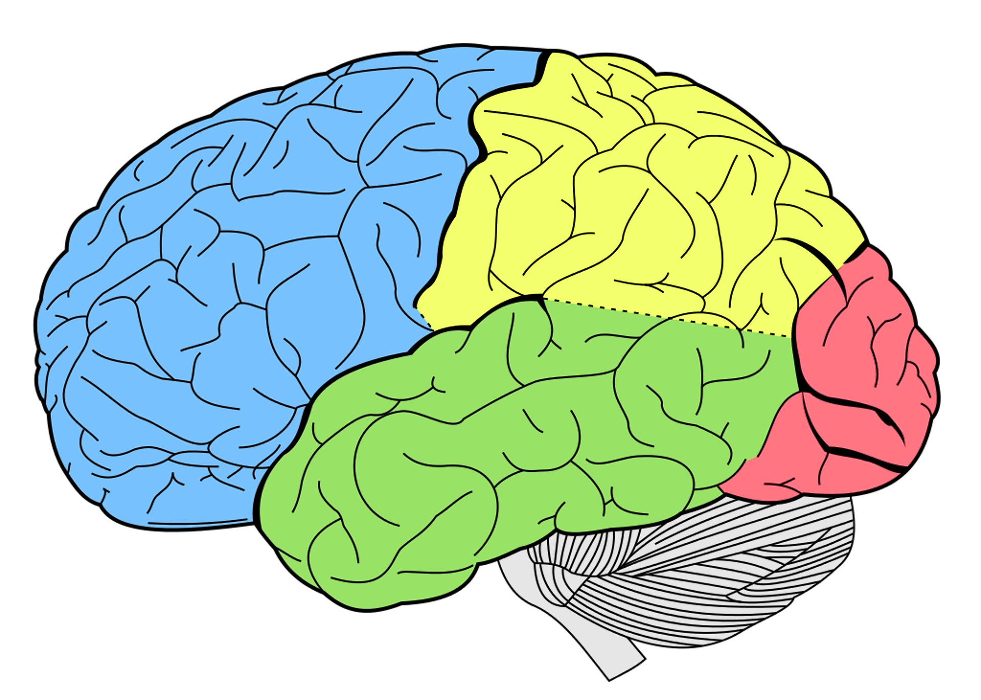


What tools do we have at out disposal?

Slide 18
Getting started with Jupyter Notebooks

Slide 19
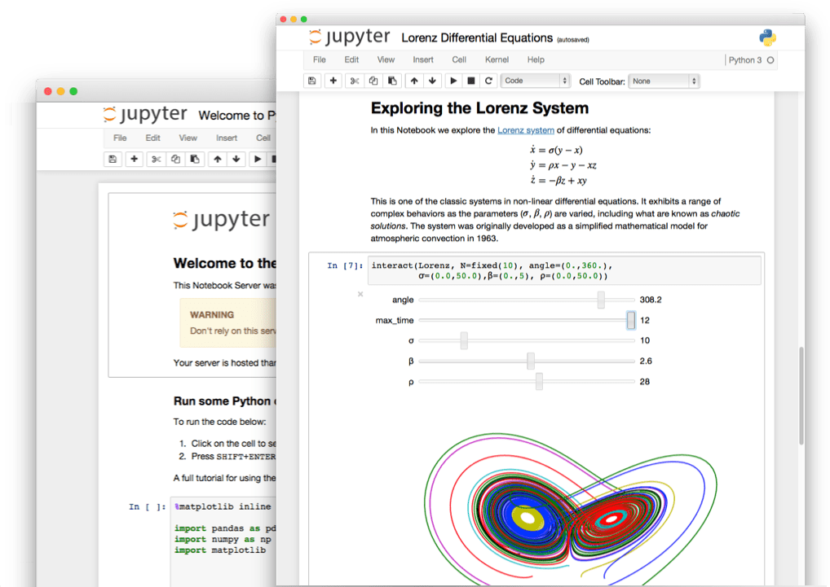
Jupyter notebooks
Jupyter notebooks are special documents that allow you to create and share documents live code.
They are a great way to keep your coding endeavors organized and share useful analysis with others.

Slide 20
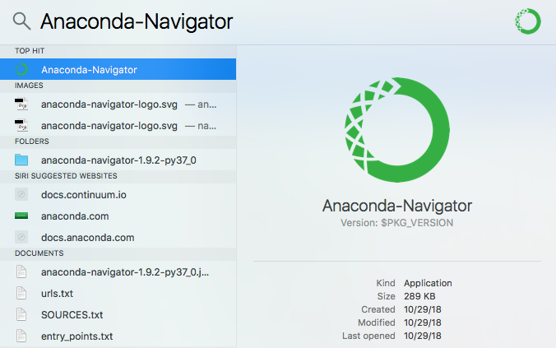
Getting started in Anaconda
Launch the Anaconda application.
MAC: Hit command+<space bar> and type “Anaconda”
WINDOWS: Look for Anaconda on your start menu
This should start you in the home directory.

Slide 21
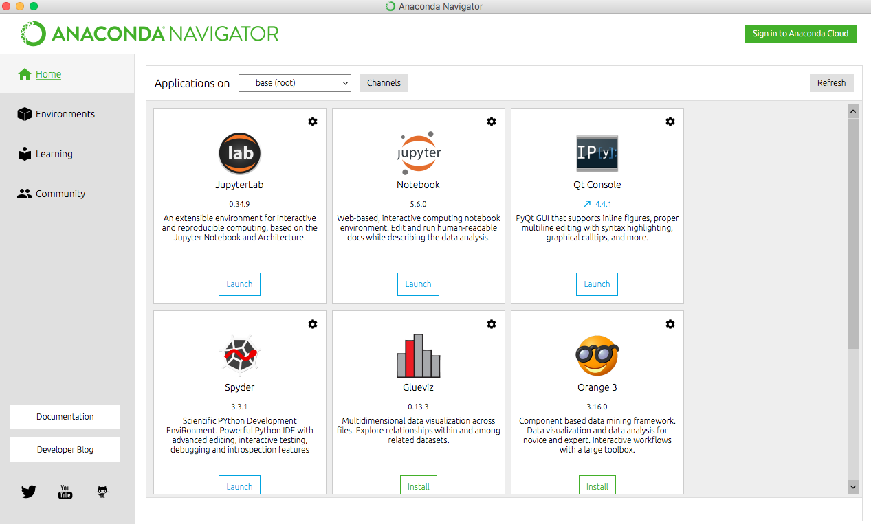
Getting started from Anaconda
Click on the launch button under the jupyter notebook icon. After a few moments the dashboard should open in your default web browser.

Slide 22
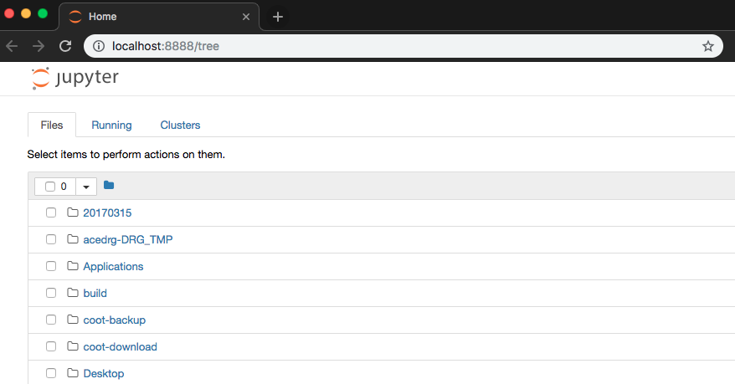
The jupyter dashboard

Slide 23
The jupyter dashboard
The file browser allows us to navigate to different locations on our computer and open specific files.

Slide 24
The jupyter dashboard
If you would like to launch in a new tab or change browser just type this url to get back there.

Slide 25
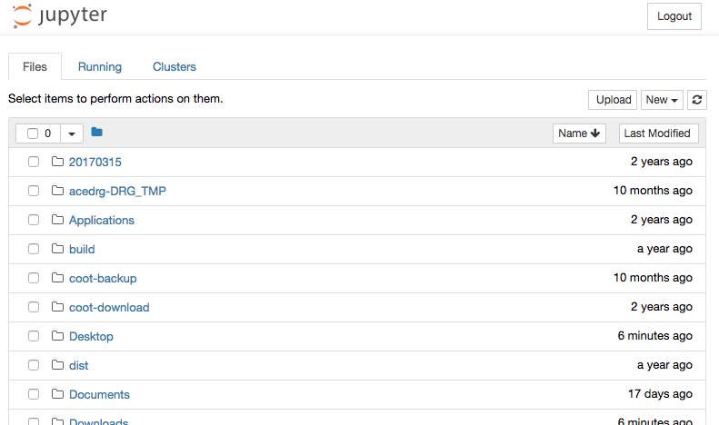
The jupyter dashboard
Let’s start by making a NEW notebook

Slide 26
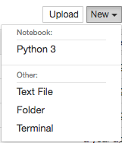
The jupyter dashboard
Make sure to select Python3.

Slide 27
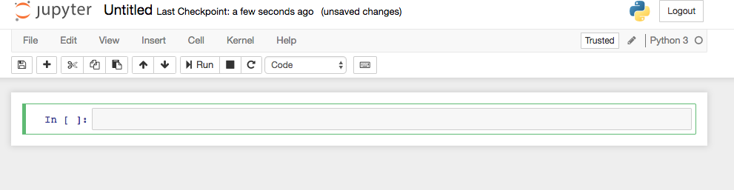
Opening your first notebook
If you have selected the right language your browser should now have a page that looks something like this opened up.

Slide 28
Opening your first notebook
We can give our notebook a filename by clicking here.
If you have selected the right language your browser should now have a page that looks something like this opened up.

Slide 29
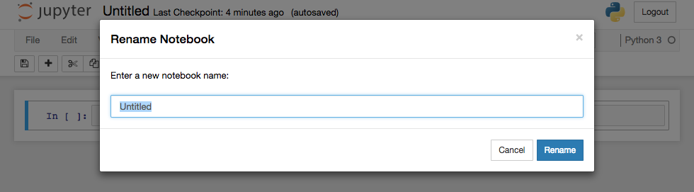
Renaming your notebook

Slide 30
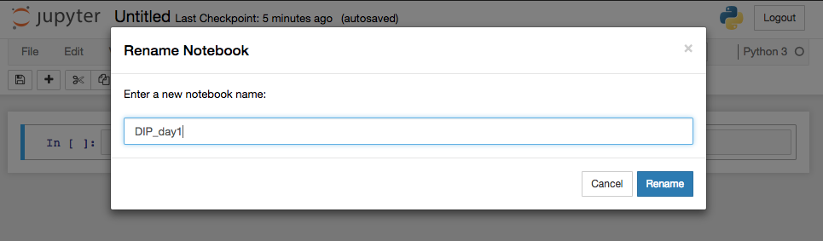
Renaming your notebook
Once you are done click rename. Your notebook should be automatically saved periodically.

Slide 31
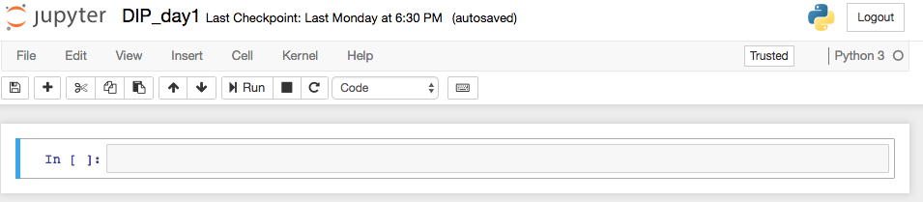
Inserting code into the notebook
The highlighted region is known as a cell and is the place where code is entered and run in your notebook.

Slide 32
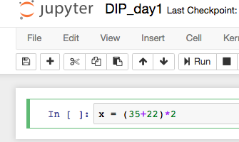
Writing and running code in Jupyter
Code can be entered directly into the cell.
Note that the text of the code has different colors.
This is known as syntax highlighting and is useful for keeping track of what specific pieces of code do.
In this case numbers are green and mathematical operations are purple.

Slide 33
Running the content of a cell
Type the code into the cell.
To run the code either press the Run button highlighted in red or:
hit COMMAND + ENTER for MAC
hit CONTROL + ENTER
This should save a variable called x with a value of 114.

Slide 34
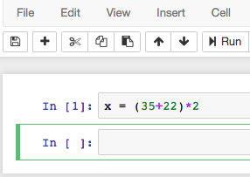
Running the content of a cell
The output is shown on the right. Did anything actually run?
The answer is yes but how do we know.

Slide 35
Running the content of a cell
The output is shown on the right. Did anything actually run?
The answer is yes but how do we know.
Notice that there is now a number in the square brackets at the side of the cell.
This means the contents of the code have been executed.
Cells that have not been executed contain empty brackets.

Slide 36
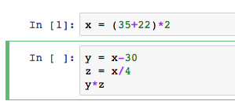
Running the content of a cell
We can actually run more than one line in a single cell.
Click on the the cell below the one you just ran and type the following code then execute it.

Slide 37
Running the content of a cell
We can actually run more than one line in a single cell.
Click on the the cell below the one you just ran and type the following code then execute it.
Individual lines can be separated by hitting ENTER. Be careful not to split up lines of code though.
The green outline shows which cell is currently active.

Slide 38
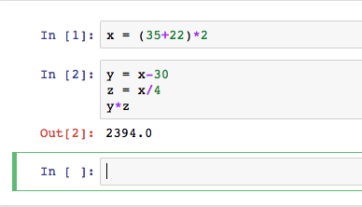
Running the content of a cell
What’s different?
This time we actually have an output printed to the screen.
The number has also been updated.
The numbers indicate the order that cells are executed.

Slide 39
Running the content of a cell
What’s different?
Jupyter will display the last line of a cell with no attribute (No ‘=’ sign).
Is there another way we can do this in python?

Slide 40
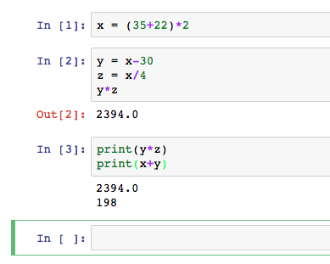
Running the content of a cell
What’s different?
Jupyter will display the last line of a cell with no attribute (No ‘=’ sign).
Is there another way we can do this in python?
With print we can display multiple things.

Slide 41
Practice – basic variables in python
Using separate cells in your notebook do the following.
Double check the value of y.
Make x a list of integers from 0 to 9.
Write a for loop that multiplies each value of x by y and prints the result.
Write a second for loop that calculates the sum of squares of the even values of x.

Slide 42
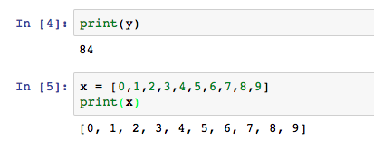
Solutions – number 1 and 2
Double check the value of y.
2. Make x a list of integers from 0 to 9.

Slide 43
Solutions – number 1 and 2
Double check the value of y.
2. Make x a list of integers from 0 to 9.
It is also possible to do this using ranges!

Slide 44
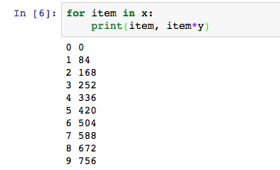
Solutions – number 3
3. Write a for loop that multiplies each value of x by y and prints the result.
This is not the only way to solve this.
Remember that lists in python can be iterated over.

Slide 45
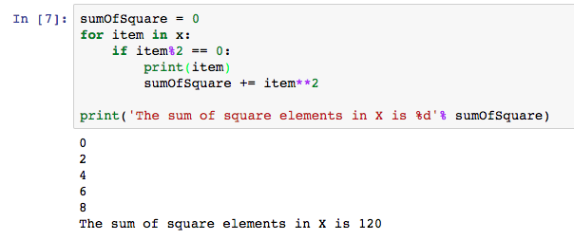
Solutions – number 4
4. Write a second for loop that calculates the sum of squares of the even values of x.

Slide 46
Solutions – number 4
4. Write a second for loop that calculates the sum of squares of the even values of x.
Using this line we are double checking that we get the even numbers only.

Slide 47
Solutions – number 4
4. Write a second for loop that calculates the sum of squares of the even values of x.
Using this line we are double checking that we get the even numbers only.
Here we are printing the final result using a string format operator (%)

Slide 48
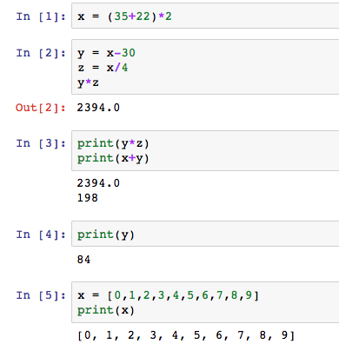
Execution order is important
Now that we have a few cells let’s go back and try and execute a cell from earlier.

Slide 49
Execution order is important
Now that we have a few cells let’s go back and try and execute a cell from earlier.
Click on the cell in the red box and run it.

Slide 50
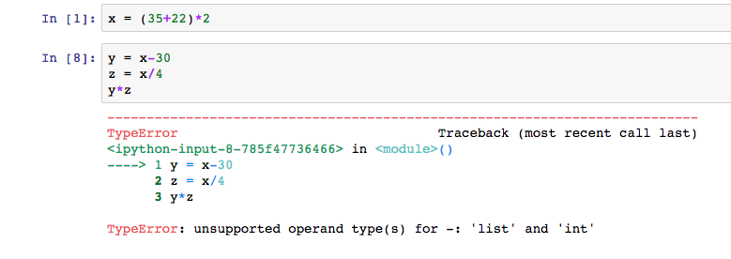
Execution order is important
Why is this error happening?

Slide 51
Execution order is important
Why is this error happening?
The line number and error message provide a good hint

Slide 52
Execution order is important
The operation ‘-’ is not supported between a list and integer.
But wait isn’t x an integer?

Slide 53
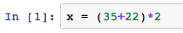
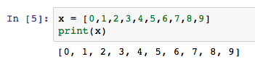
What is going on?
Initially we had defined X as an integer.
Then we redefined it as a list.
So now the mathematical operation doesn’t make sense.

Slide 54
What is going on?
Initially we had defined X as an integer.
Then we redefined it as a list.
So now the mathematical operation doesn’t make sense.
Be careful that the order of your operations still makes sense when rerunning cells.

Slide 55
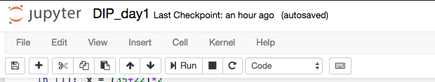
Restarting the notebook
If you do mess up the order in which your cells are running and you are not sure how to recover, you can restart your notebook from the tool bar.

Slide 56
Restarting the notebook
If you do mess up the order in which your cells are running and you are not sure how to recover, you can restart your notebook from the Kernel button in the tool bar.

Slide 57
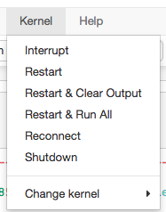
Restarting the notebook
If a cell freezes interrupt it.
Restarts and clears the values assigned to all variables.
As above but also removes displayed output.
As above but also executes all cells.

Slide 58
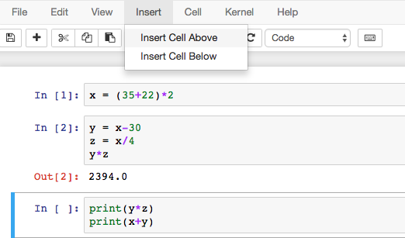
Adding text to your notebooks
Jupyter notebooks supports the markdown language allowing you to add annotation to your code.
Let’s try this out by adding a new cell.

Slide 59
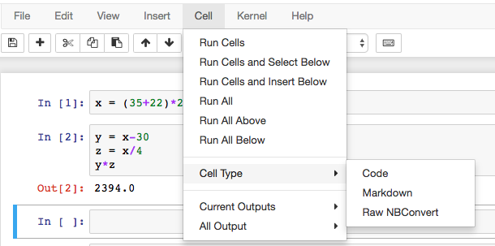
Adding text to your notebooks
Now set the type of the new cell

Slide 60
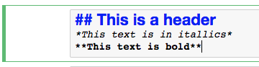
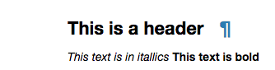
Adding text to your notebooks
Now we can type in our text and execute.
Using both markdown and code in this way is one of the most powerful things about notebooks and makes for great reports.

Slide 61
Saving and loading notebooks
You’ll notice at the top that Jupyter does autosave however it is best to save periodically.
You can use the following keyboard shortcuts:
MAC: Command + s
WINDOWS: Control + s
By default the notebooks save in the same folder you opened them.

Slide 62
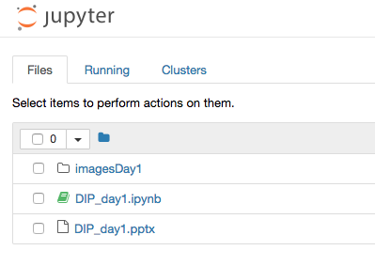
Saving and loading notebooks
Notebooks are still files and they have the extension .ipynb
They are easy to find on the dashboard as they have a gray icon if they are inactive or a green icon if they are active.

Slide 63
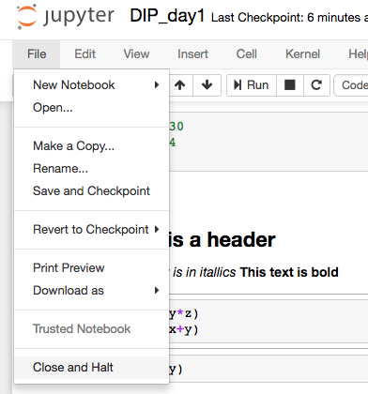
Properly closing a notebook
When you are done with your notebook the safest way to exit is to close and halt.
This option is found under the file tab of the toolbar.

Slide 64
Conclusion
This concludes the introduction to Jupyter notebooks.
We will be using notebooks for the remainder of the workshops and they will be available on the github page.
The best way to learn more about notebooks is to use them and checkout other peoples.
https://github.com/jupyter/jupyter/wiki/A-gallery-of-interesting-Jupyter-Notebooks
The above link contains a lot of examples of notebooks exploiting a range of different features

Slide 65
Key libraries for images in python
After a short break.

Slide 66
Libraries we will be using
One of python’s major advantages is it’s extensive libraries that have been developed for a variety of different applications.
I’ll be focusing this workshop on the libraries shown here.

Slide 67
Numpy
Numpy is a python library set up for manipulating large multidimensional arrays of data, or matrices.
Numpy has its own variable types and is used ‘under the hood’ by many other libraries (such as SciKit-Image and SciPy).
Numpy also contains specific matrix versions of a lot of the mathematical functions found in the math library.
Let’s use the same notebook to import numpy.

Slide 68
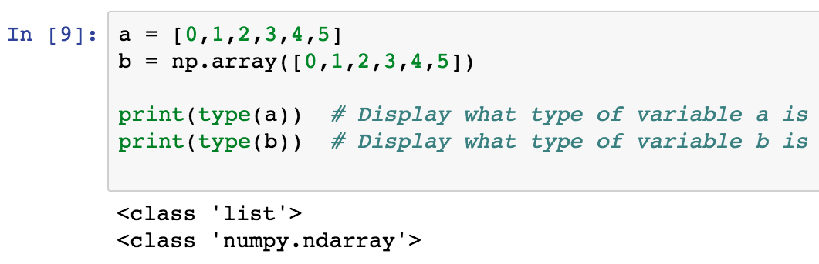
Lists Vs. Numpy arrays
Numpy arrays are special variables that allow the user to perform matrix and vector like operations.
They look like lists but don’t be fooled their behavior is different.

Slide 69
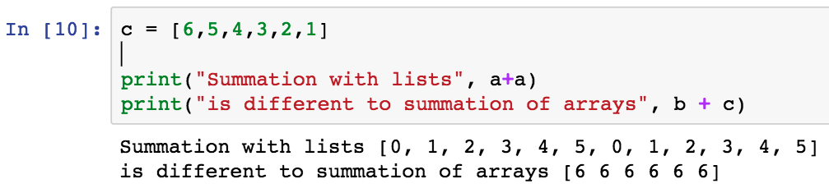
Lists Vs. Numpy arrays
Mathematical operations work differently with lists vs. numpy arrays.
You can see that addition concatenates lists, whilst with arrays we get the elementwise addition.

Slide 70
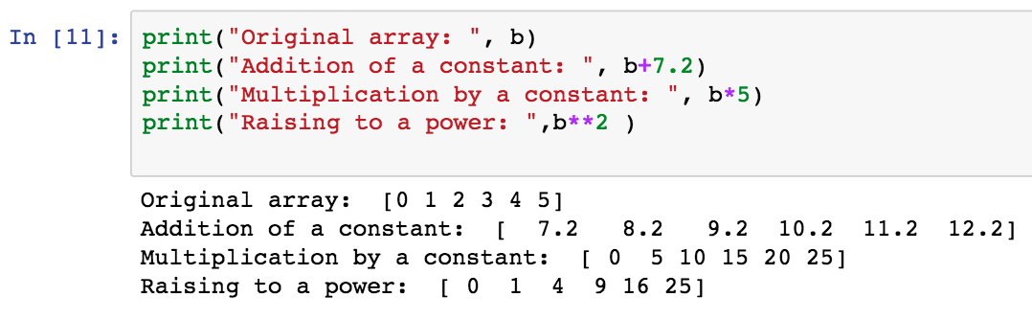
Mathematical operations on numpy arrays
However most mathematical operations still work as expected.

Slide 71
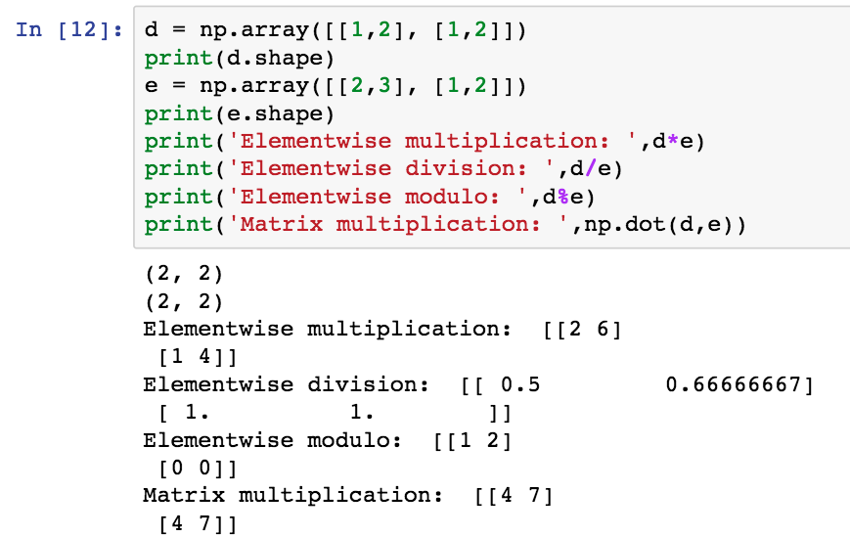
Element wise vs matrix multiplication
Two different ways to multiply numpy arrays. Be careful to choose the right one.

Slide 72
Element wise vs matrix multiplication
Two different ways to multiply numpy arrays. Be careful to choose the right one.
Numpy array are “obejcts”. This means they have special properties called attributes and methods()
More on this later.

Slide 73
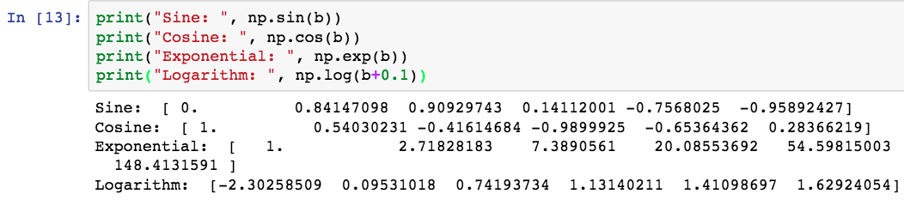
Other operations

Slide 74
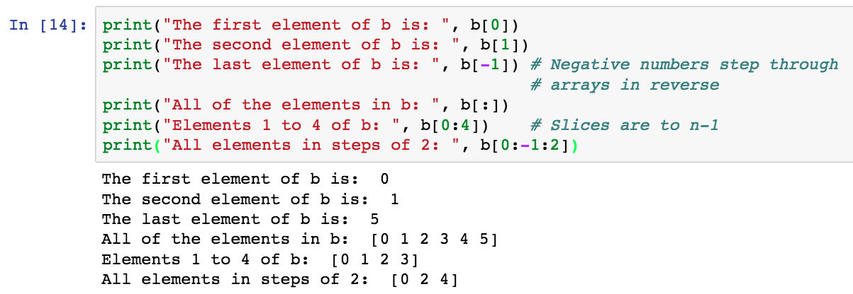
Indexing numpy arrays

Slide 75
Indexing numpy arrays
The syntax for this is always
START:END:STEP

Slide 76
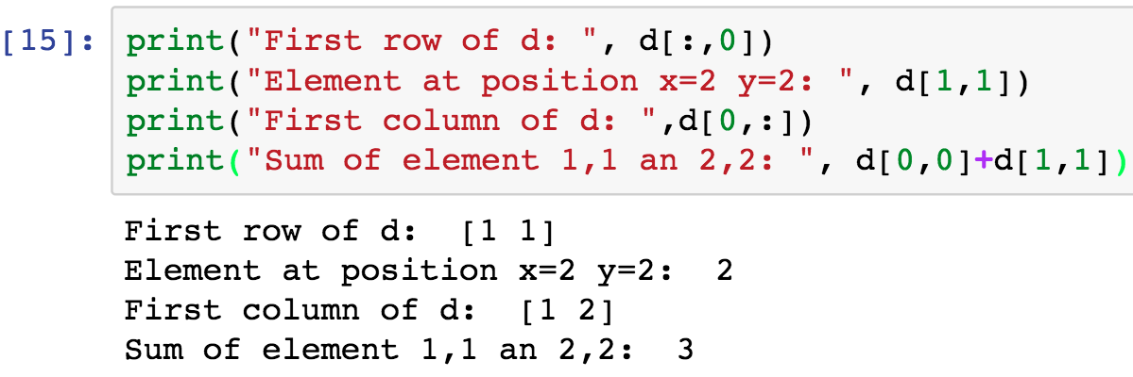
Indexing also works in 2D

Slide 77
Attributes and methods
Attributes and methods are special properties and functions that objects carry with them and provide additional functionality.
Both require a dot (.) after the array to be used.
Attributes require just the word.
Methods() require brackets.

Slide 78
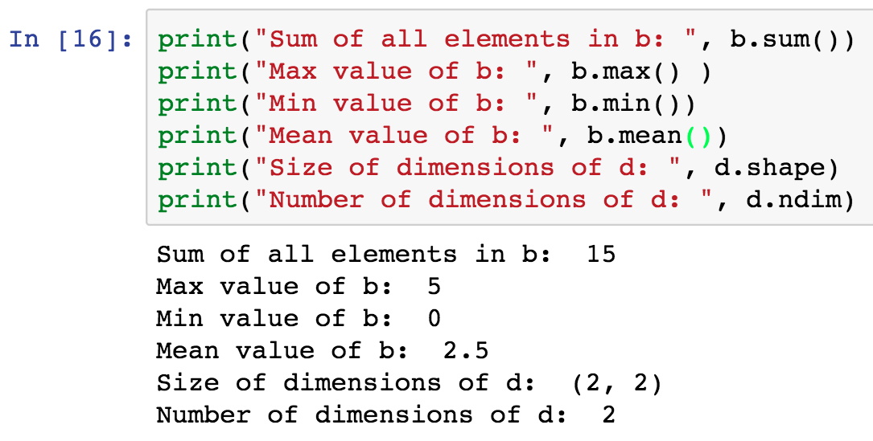
Attributes and methods

Slide 79
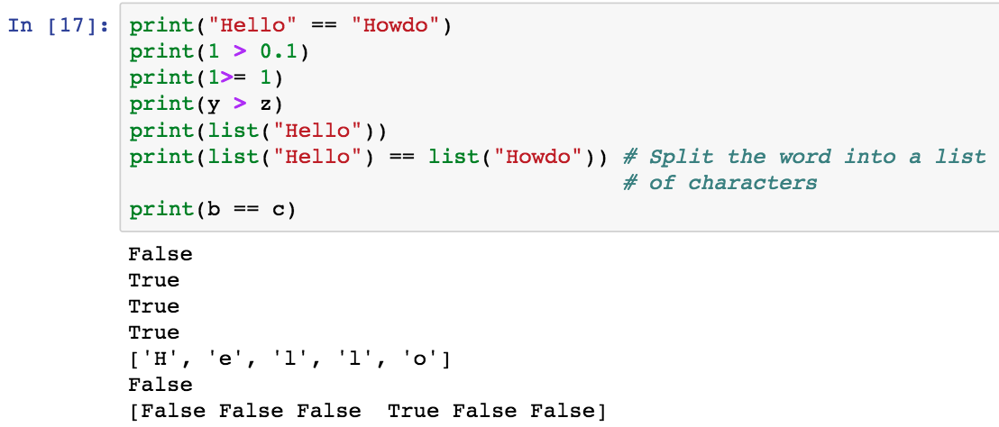
Logical operators also work on arrays
Logical operators are an important means for comparing variables.
They work with numbers, strings and of course arrays.
This is useful as it gives us a means to select particular elements in an array.

Slide 80
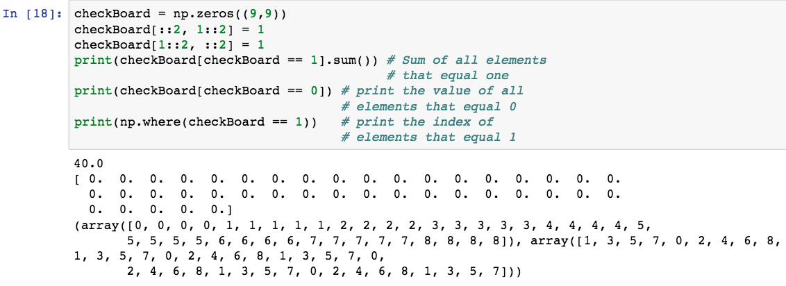
Logical indexing in arrays
Logical operators are also useful ways of extracting relevant information from 2D arrays.

Slide 81
Matplotlib for graphing and viewing images

Slide 82
Currently the most commonly used plotting library in python.
It contains many functions for creating publication quality graphs.
It also has many tools for importing and displaying images of different types.

Slide 83

Importing matplotlib and displaying
Matplotlib can be used to display images directly in jupyter.
Let’s use matplotlib to have a look at the checkboard we created earlier.

Slide 84
Importing matplotlib and displaying
Matplotlib can be used to display images directly in jupyter.
Let’s use matplotlib to have a look at the checkboard we created earlier.
These libraries provide the main functionality for working with images.

Slide 85
Importing matplotlib and displaying
Matplotlib can be used to display images directly in jupyter.
Let’s use matplotlib to have a look at the checkboard we created earlier.
These libraries provide the main functionality for working with images.

Slide 86

Example: plotting a 2D function
To learn some features of matplotlib we will make the following figure.

Slide 87

Example: plotting a 2D function

Slide 88
Example: plotting a 2D function
Here we are defining the dimensions of the image in pixels.

Slide 89
Example: plotting a 2D function
Next we create a matrix that contains values that increase as a function of distance from the center of the image.

Slide 90
Example: plotting a 2D function
We use logical indexing to define two circles of a particular radius

Slide 91
Example: plotting a 2D function
This creates a figure object and defines its aspect ratio

Slide 92
Example: plotting a 2D function
We can now define a series of subplots to display the matrices that were created above.

Slide 93
Example: plotting a 2D function
Subplot takes the form:
Number of images in the first dimension(1)
Number of image in the second dimension(3)
Current image(1)

Slide 94
Example: plotting a 2D function
Finally we call plt.show( ) to display the image in the notebook.

Slide 95
Example: plotting a 2D function
Alternatively if we wanted to save the image we could type plt.savefig(‘circles.png’,dpi=300)

Slide 96

To learn more about plotting
matplotlib.org

Slide 97
Loading an image using matplotlib
Matplotlib can natively load .png files, however it can also interface with pillow (another python library) to load other file types.
Don’t worry pillow comes bundled so you don’t need to install it.
There are some other libraries that you may need to deal with more unconventional image types (such as movie frames, h5 format and proprietary format).
These are out of the scope of these lectures but feel free to ask me about them if you have a specific dataset in mind!

Slide 98

Loading an image using matplotlib
Load the image using imread and check out the images properties.

Slide 99
Loading an image using matplotlib
Load the image using imread and check out the images properties.
If you are on windows please load the png image instead.

Slide 100
Loading an image using matplotlib
Load the image using imread and check out the images properties.
From this we can see that it is a color image.

Slide 101
Loading an image using matplotlib
Load the image using imread and check out the images properties.
Looking at the max and min values lets you know the Image type (in this case 24 bit (8 x3))

Slide 102

Loading an image using matplotlib
Imshow will display the image.

Slide 103

Loading an image using matplotlib
We can also look at all channels individually by slicing the matrix.

Slide 104

Loading an image using matplotlib
We can also look at all channels individually by slicing the matrix.

Slide 105
Converting an image to grayscale
Having access to individual RGB channels can be useful, but sometimes we want act on the image as a whole. To do that we need to convert the 3 channel image into a single gray channel image.
The conversion can be performed using the following transformation:
L = R * 0.299 + G *0. 587 + B * 0.114
Let’s make a function to do this.

Slide 106

Converting an image to grayscale

Slide 107
Converting an image to grayscale
Function definitions always start with def and are terminated with a semicolon.

Slide 108
Converting an image to grayscale
Return allows us to extract an output from our function.

Slide 109

Converting an image to grayscale

Slide 110
Converting an image to grayscale
We have now lost a dimension, the image is truly grayscale.

Slide 111
Converting an image to grayscale
Note that after the scaling the image now contains non integer values.

Slide 112

Converting an image to grayscale

Slide 113

We can also do the same thing with built in functions
Scikit-image is a python library with A LOT of useful built in function for image processing. We’ll talk more about it tomorrow.

Slide 114
We can also do the same thing with built in functions
Note that skimage performs a slightly different scaling

Slide 115
We can also do the same thing with built in functions

Slide 116
What have we learned so far
Some basic definitions of an image, image types and digital processing workflows.
Recap of some key ideas in python.
How to use jupyter notebooks, numpy and matplotlib to work with matrices and images.
How to load and do some simple image manipulations.

Slide 117
What is happening tomorrow?
We are going to delve further in to sci-kit image.
We will look at preprocessing steps including:
denoising, normalizing and filtering of images.
Cover the most popular algorithms for doing these things
Look at some more advanced denoising algorithms
Filtering in the fourier domain.
We will also cover some basic thresholding and segmentation of images to extract interesting ROIs.

Slide 118
Practice if you have time
Try comparing the two grayscale pepper images, is there a simple scaling factor that makes them different or is the formula for how they were made different.
Try loading your own image into your notebook.
Find the pixel locations of the maximum and minimum values.
Invert the image.
Try writing a for loop that will iteratively change the maximum intensity to the mean value of the image.

Slide 119


For more information
http://web.ipac.caltech.edu/staff/fmasci/home/astro_refs/Digital_Image_Processing_2ndEd.pdf
http://programmingcomputervision.com/

